Slide 1

Word vectors, sentence embeddings,
and other strange things
Nancy Fulda
XKCD.com
BYU DRAGN Labs
DRAGN.ai

Slide 2
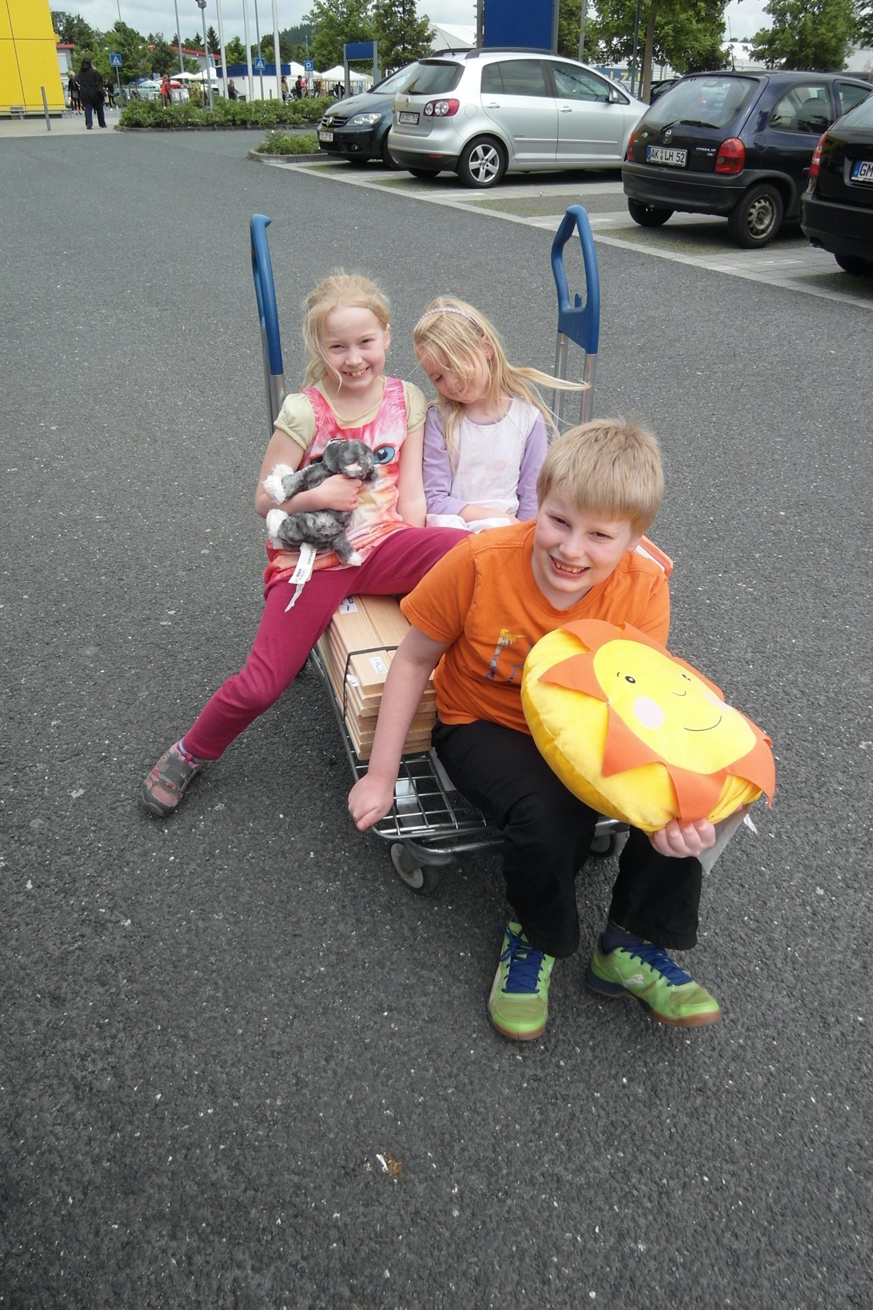
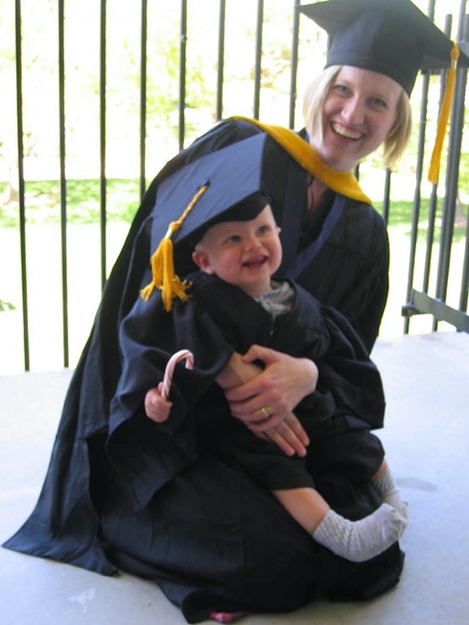
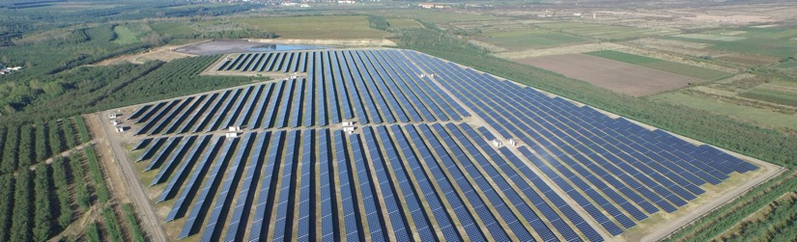




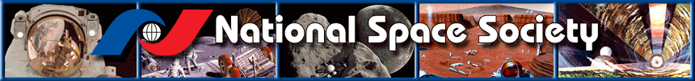
Nancy Fulda
MS 2004

Slide 3

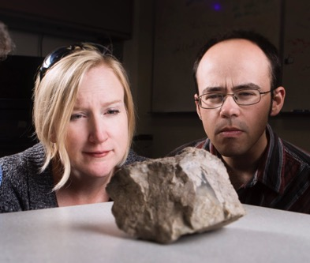
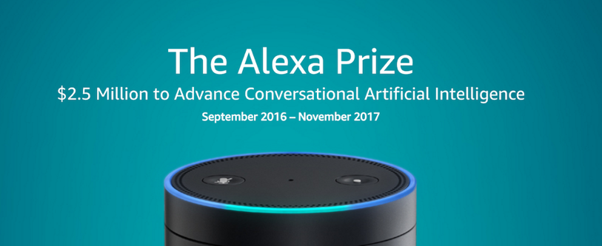
Nancy Fulda
MS 2004
PhD 2019

Slide 4

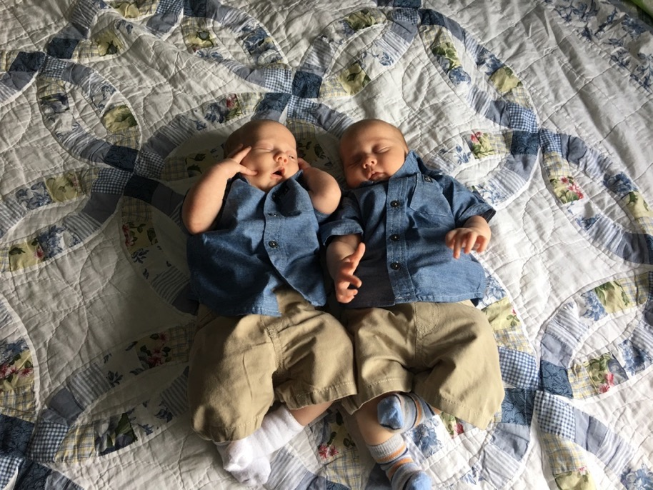
Nancy Fulda
MS 2004
PhD 2019
Joshua and Micah
Nathan

Slide 5
So much for me.

Slide 6
How about you?

Slide 7

What can you do with a rock?
Affordance extraction via word embeddings
Nancy Fulda, Daniel Ricks, Ben Murdoch, David Wingate
BYU DRAGN Labs
DRAGN.ai

Slide 8



Ben Murdoch
Daniel Ricks

Slide 9
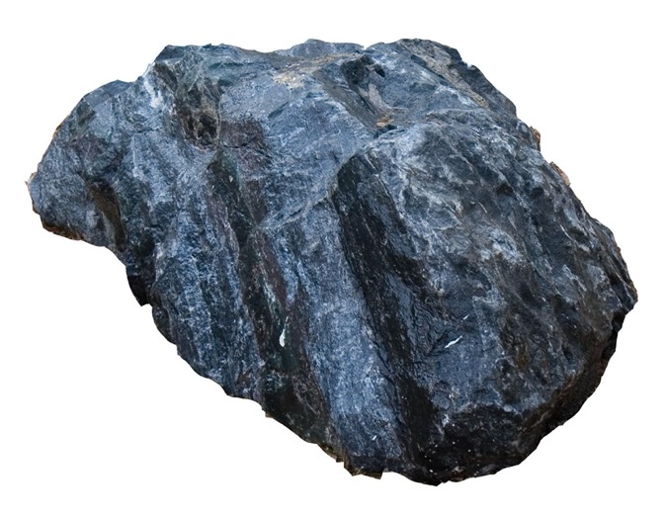
Affordance
The possibility of an action on an object or environment.

Slide 10

video from c2ro.com

Slide 11


Slide 12

supervise airplane?
ignore airplane?
melt airplane?
type airplane?
smudge airplane?
eat airplane?
blend airplane?
discuss airplane?
resent airplane?
© Can Stock Photo / Choreograph
annoy airplane?
vote airplane?
digest airplane?
correct airplane?
build airplane?
brush airplane?
think airplane?
learn airplane?
irrigate airplane?
rewire airplane?
review airplane?
transcend airplane?
dethrone airplane?
crimp airplane?
avenge airplane?
cut airplane?
pilot airplane?
forgive airplane?
pour airplane?
fly airplane?
Notes:
We’re just going to do it all with words. And we can imagine that later we can attach those words to physical realities. Because as scientists, we make a spherical cow.

Slide 13
How can we imbue a synthetic agent with this same common sense knowledge?

Slide 14
Learn it
Code it
Harvest it

Slide 15

Photo: Tatiana Bobkova

Slide 16

Trinity College Library
Notes:
To recap: In this case, the big idea is that we don’t need to hand-code all the knowledge the agent might need. Why? Because every-day, general purpose common-sense knowledge is already intrinsically present in one of humanity’s most prolific constructs: Literature. Books, news articles, letters, blog posts...
%So right now you’re thinking, “Well, that sounds great Nancy, but how do you intend to do that exactly? This is starting to sound more like magic than science.”

Slide 17

Online text corpora contain implicit common sense knowledge
This knowledge:
(a) Requires no explicit maintenance
(b) Includes unintuitive but relevant data
Notes:
But there is a third alternative. Previous researchers have shown that unstructured text corpora can be used to create an embedding space in which each word is represented as an n-dimensional vector. So we asked ourselves – what if we used Mikolov et al.’s word2vec algorithm on a tagged Wikipedia corpus, and then treated the resulting word vectors as a common sense knowledge base?
Such a knowledge base would (a) require no explicit maintenance, and (b) would include relationships that human curators might miss.

Slide 18

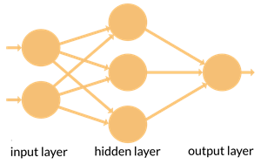
Word embeddings
cat | chair | door | pants
-0.021 | 0.137 | -0.211 | -0.004
0.184 | 0.915 | -0.002 | 0.102
0.164 | 0.033 | 0.039 | -0.016
-0.060 | -0.162 | 0.043 | -0.083
0.017 0.056 | 0.158 -0.011 | -0.036 -0.981 | -0.155 0.113

Slide 19
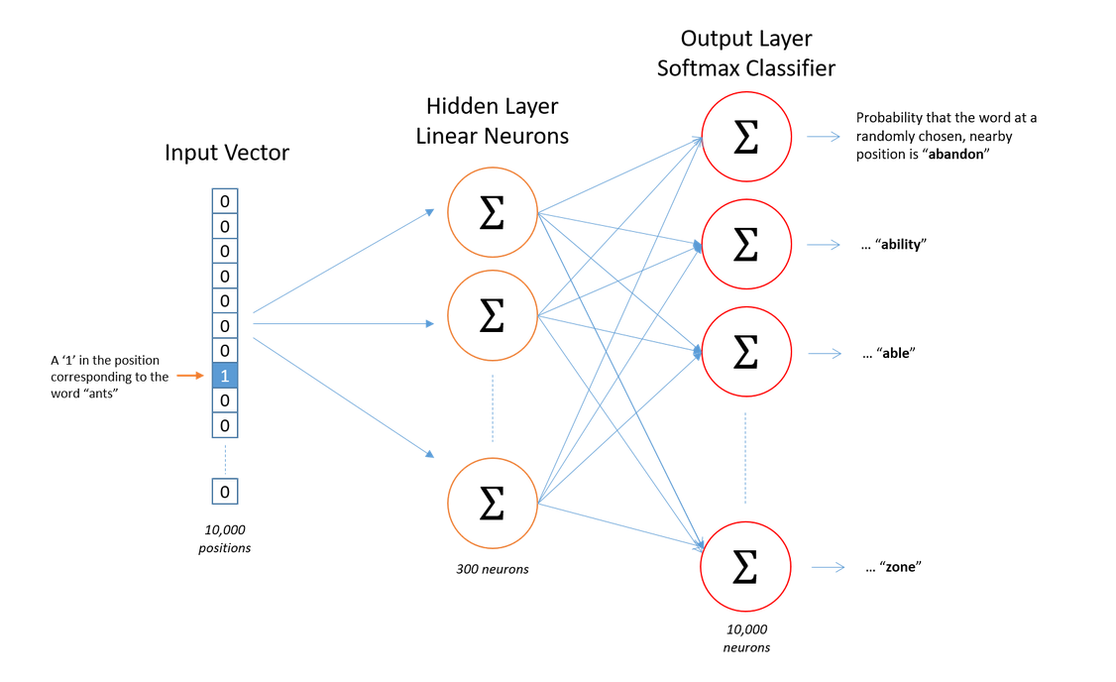
Training algorithm
image from Chris McCormick, http://mccormickml.com/2016/04/19/word2vec-tutorial-the-skip-gram-model/

Slide 20
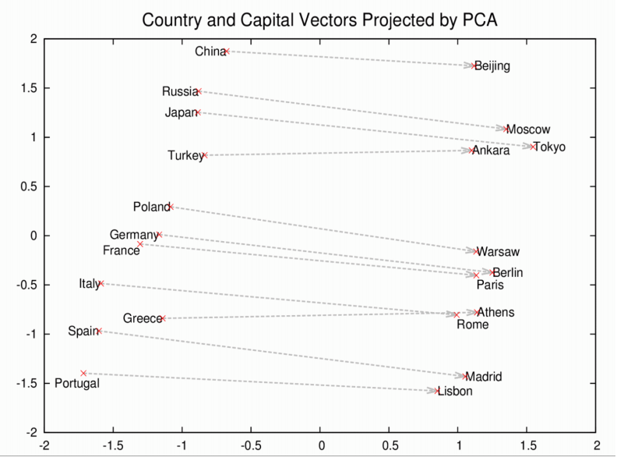
Vector Space Models
Image from https://skymind.ai/wiki/word2vec

Slide 21
Vector Space Models
Geography: Rome - Italy = Beijing - China
Gender stereotypes: king - man + woman = queen
Syntax: running - ran + swimming = swam
Geopolitics: Iraq - violence = Jordan
Moral code: human - animal = ethics
Distinction: library - books = hall

Slide 22
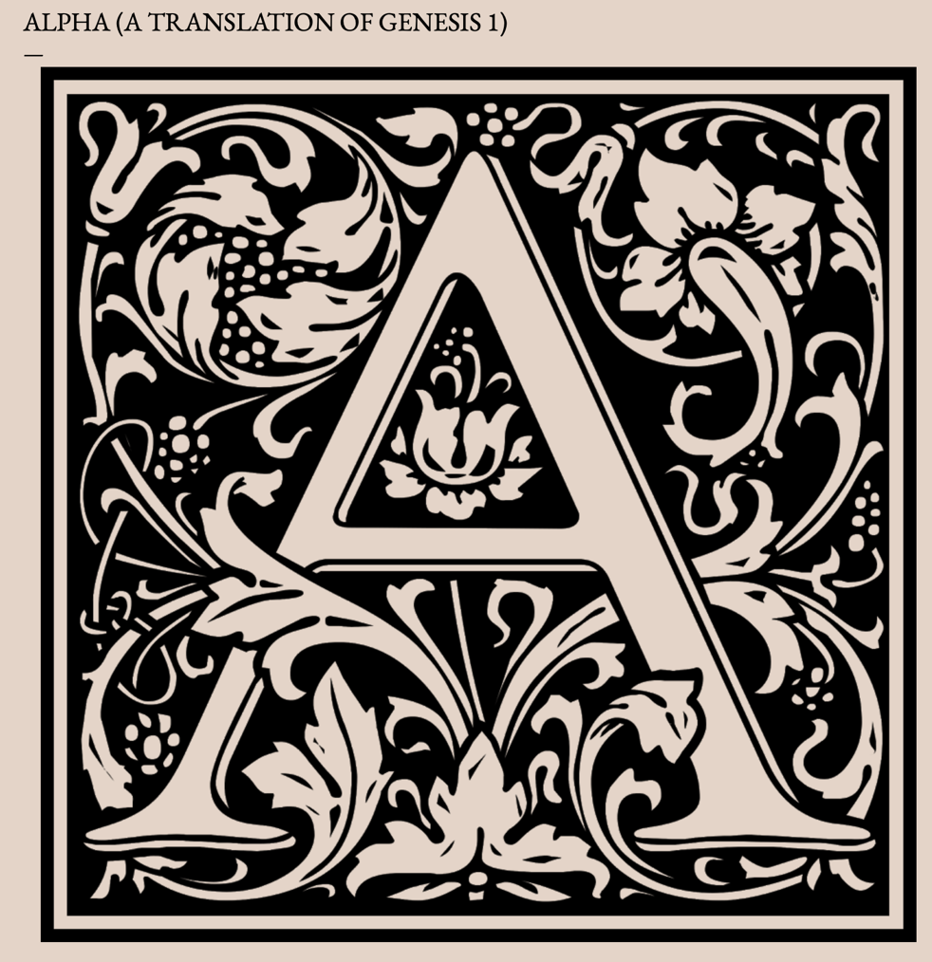
http://llamasandmystegosaurus.blogspot.com/2017/05/alpha.html

Slide 23
1. An advent: ancient archangels architect abstract astronomy and arid asteroids.
2. All asteroids are amorphous and absent; And all asleep across aquatic anarchy. And astral angels advanced across area.
3. And Almighty asked," Appear." And all appeared aglow.
4. And Almighty approved. Aura and absence: an antagonistic arithmetic.
5. An afternoon and aurora, an aeon.
6.And atmosphere and all awash abscinded.
7. Astral air above; aquatic area abased. All as Almighty asserted.
8. Angel's abode appeared. Another afternoon, another aurora. Another aeon.
9. And Almighty authored aquatic archipelagos. Arable acreage appeared.
10. And Almighty approved.
11. Abundant agricultural affluence: azaleas, anise, amaranth. And apples and apricots, almonds and acacias, an arboreal appearance.

Slide 24
1 In the beginning God created*the heaven and the earth.
2 And the earth was without form, and void; and darkness was upon the face of the deep. And the Spirit of God moved upon the face of the waters.
3 And God said, Let there be light: and there was light.
4 And God saw the light, that it was good: and God divided* the light from the darkness.
5 And God called the light Day, and the darkness he called Night. And the evening and the morning were the first day.
6 And God said, Let there be a firmament in the midst of the waters, and let it divide the waters from the waters.
7 And God made the firmament, and divided the waters which were under the firmament from the waters which were above the firmament: and it was so.
8 And God called the firmament Heaven. And the evening and the morning were the second day.
9 And God said, Let the waters under the heaven be gathered together unto one place, and let the dry land appear: and it was so.
10 And God called the dry land Earth; and the gathering together of the waters called he Seas: and God saw that it was good. 11 And God said, Let the earth bring forth grass, the herb yielding seed, and the fruit tree yielding fruit after his kind, whose seed is in itself, upon the earth: and it was so.
1. An advent: ancient archangels architect abstract astronomy and arid asteroids.
2. All asteroids are amorphous and absent; And all asleep across aquatic anarchy. And astral angels advanced across area.
3. And Almighty asked," Appear." And all appeared aglow.
4. And Almighty approved. Aura and absence: an antagonistic arithmetic.
5. An afternoon and aurora, an aeon.
6.And atmosphere and all awash abscinded.
7. Astral air above; aquatic area abased. All as Almighty asserted.
8. Angel's abode appeared. Another afternoon, another aurora. Another aeon.
9. And Almighty authored aquatic archipelagos. Arable acreage appeared.
10. And Almighty approved.
11. Abundant agricultural affluence: azaleas, anise, amaranth. And apples and apricots, almonds and acacias, an arboreal appearance.

Slide 25
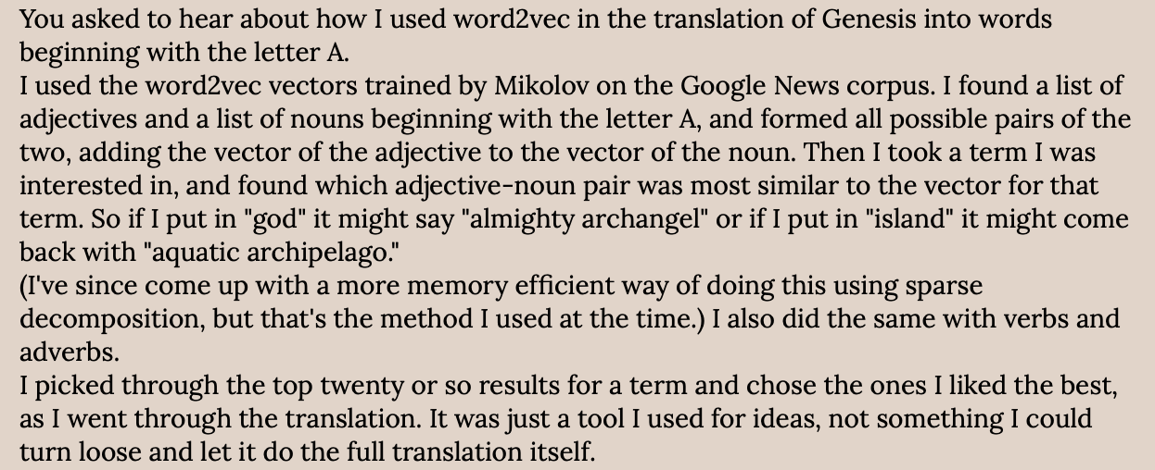

Slide 26
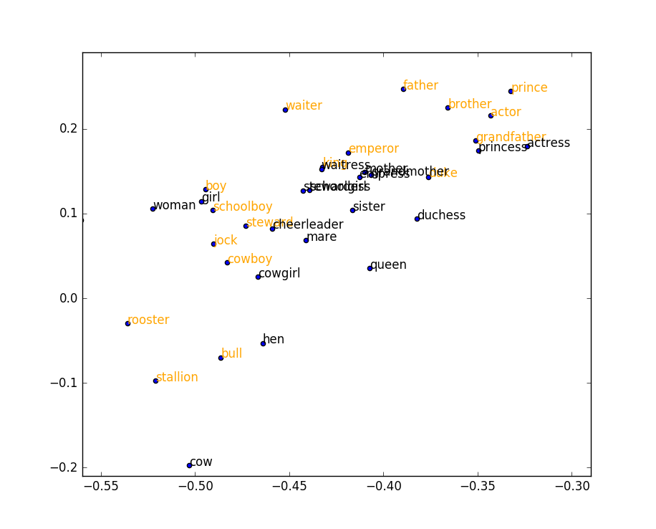
Word vectors
We know the structure is present, but how do we access it?
PCA Reduction
Notes:
So how does this look in practice?
Well, for one thing, you can use these queries to create a classifier.
We wanted to go beyond simple analogies. We also wanted to be able to classify and sort words according to user-defined properties. From research done by others, we know that the inherent structure is present in the word embeddings – but extracting that information is not always straightforward. For example, let’s say we want to distinguish between masculine and feminine terms. A simple PCA reduction – which works so well in so many other contexts – does not reveal the structure that we’re looking for.

Slide 27
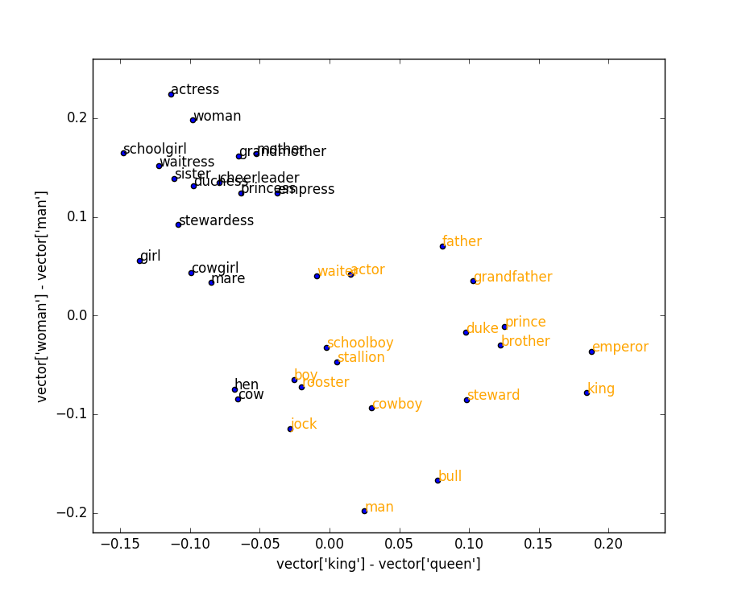
Word vectors
Notes:
However, if the n-dimensional vectors are projected onto a two-dimensional subspace defined by an analogy query, the structure becomes visible. The masculine and feminine terms are now linearly separable.
One key advantage of this approach: No technical knowledge is required to set the classifier’s parameters. The user merely gives an example of the type of relationship that is sought. (In fact, “man” – “woman” works much better than “male” – “female”.)

Slide 28
Word embeddings as a knowledge base
sun::yellow as grass::???
“grass is green”
Analogy -> query
Set of embeddings -> database
Notes:
Our objective was to take this process even farther. If you can answer an analogy question like “sun is to yellow as grass is to green”, then to a certain extent, the system “knows” that “Grass is green.” Thus, an analogy becomes a query, and the embedding space becomes a database.

Slide 29
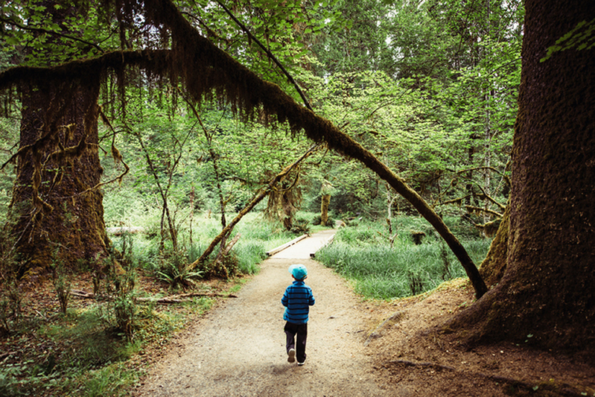

A world made of words
You find yourself on a forest path surrounded by tall trees and other vegetation.
Climb trees
Follow path
Eat Forest
Reboot trees
8.5 x 10⁸ distinct actions
Notes:
So we said, “All right. This is cool, but can we extract knowledge that’s actually useful for decision-making? How far can we take this?”
To test our ideas, we created an agent that exists entirely in the linguistic realm. What does that mean? It means that all video input, sensor data, etc. is supplanted by a sophisticated, abstract representation that we call ‘words’. And the agent’s action space is also represented in the same way.
So this is what the world looks like to the agent: He gets some text describing the environment. The text is parsed to obtain a list of nearby objects, much as an image processing algorithm might produce a list of object labels. And then, the agent is asked to construct simple two-word commands like “climb trees” or “follow path”. Notably, we *don’t* want the agent to attempt unreasonable commands like “eat forest” or “reboot path”.
Now, lest anyone mistake this for a trivial problem, let me point out that there are over 85,000 nouns and at least 10,000 verbs in the English language, and most of those verb/noun pairs are not affordant combinations. And… I’m not even going to speculate about the size of the state space.

Slide 30
Object Selection
An object is relevant if:
It is proximate to the agent
It is easily manipulable

Slide 31

Finding proximate objects
You find yourself on a forest path surrounded by tall trees and other vegetation.
You find yourself on a forest path surrounded by tall trees and other vegetation.
forest
path
trees
vegetation
tall trees
other vegetation
Notes:
So it just happens there’s a whole suite of games like this, and kind people have collected them and saved them, and now we can evaluate our methods on a system we didn’t design - it’s somebody else’s system.

Slide 32
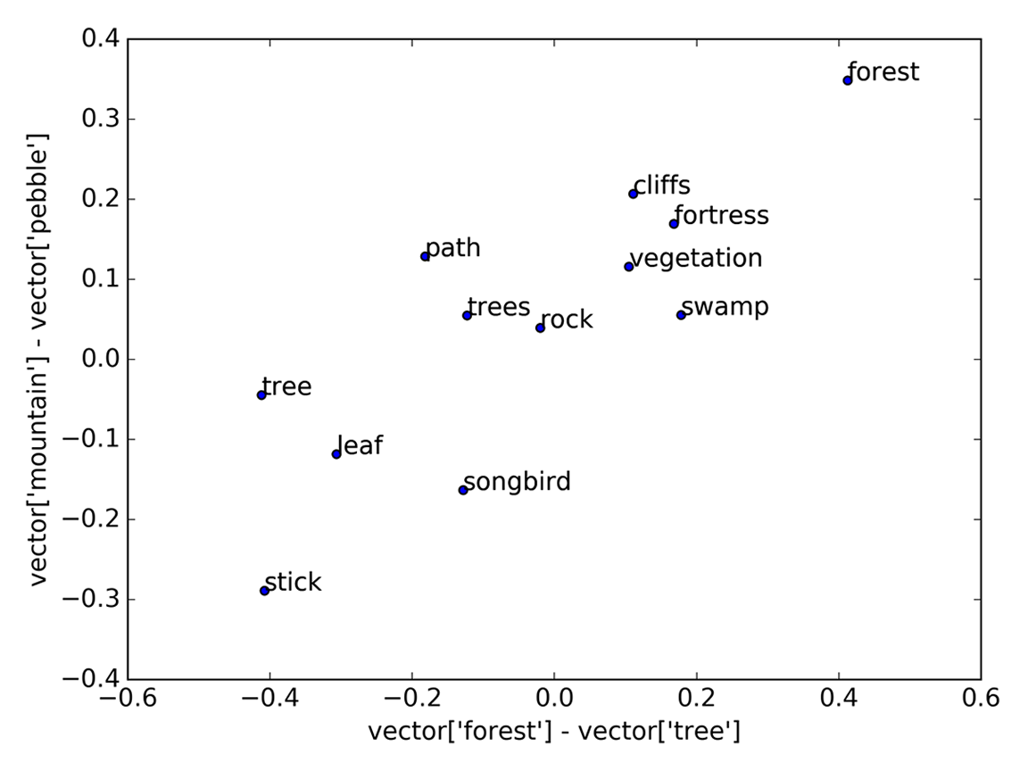
Measuring manipulability
We project each word onto a user-defined manipulability vector

Slide 33
Finding affordant verbs
sing
nail
read
hammer
book
ride
song
horse
(what can you do with a tree?)
Notes:
Ok, so we’ve got our object, represented as a noun. And we’ve got 10,000 or more verbs to choose from. How do we
Answer: We query the database!
Affordance is a sophisticated concept – far trickier than matching countries to capitals or swapping between verb tenses. So instead of using a single exemplar to construct our query, we construct something we call a canonical example. We start by taking a set of exemplars of the type of relationship we’re looking for, then subtracting the average of the nouns from the average of the verbs to create what we call a canonical affordance vector. Conceptually, this vector represents the query “What can you do with item X”?

Slide 34
Finding affordant verbs
perch
climb
plant
sprout
tree
fell
Notes:
So to find the affordant verbs for “tree”, we begin with the point that represents “tree” in the embedding space. Then we add the canonical affordance vector to it, and find the nearest words to the resulting point. What can you do with a tree?

Slide 35
Finding affordant verbs
wield
summon
unsheathe
vanquish
sword
duel
Notes:
Similarly, the first five results for ‘sword’ are vanquish’, ‘duel’, ‘unsheathe’, ‘wield’, ‘summon’.

Slide 36
How can we evaluate the quality of our harvested knowledge?

Slide 37


Test environment
You are behind the white house. In one corner of the house there is a small window which is slightly ajar.
?
1000 verbs
from Wikipedia
house
corner
window
window
Notes:
Objective: get points
Depending on the game, brute force could take from a few million to a few trillion game steps to fully explore the search space - or more. We turn this loose on 50 games – 1 had a termination error and was excluded from consideration. 31 were unlearnable because our agent didn’t use prepositions, etc. That leaves 18...

Slide 38
Question 1:
Does our harvested knowledge improve agent performance?

Slide 39
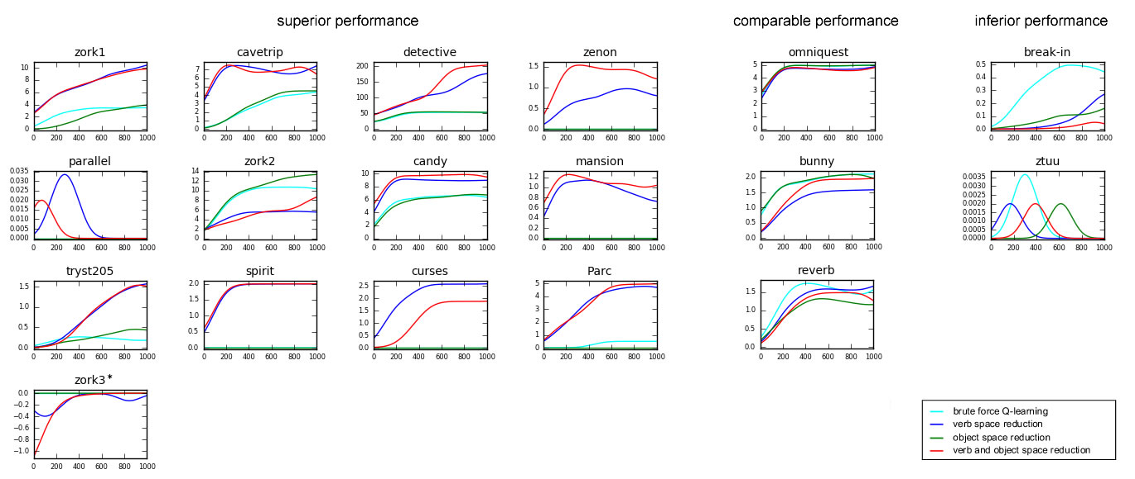
Yes.
Notes:
The cyan line is our baseline agent – it identifies proximate nouns, but nothing else. The red, green and blue lines are all variations of our algorithm.
(Talk the audience through a few examples – “in zork1, we see that our affordance knowledge allowed the agent to triple its score”; “In curses, the baseline agent wasn’t able to earn any points at all – but here, our noun selection algorithm betrayed us – it disregarded an object that it should have used.” “Zork3 was particularly interesting. In this game, it was possible for the agent to lose points by dying. The baseline agent never made it far enough in the game to die, but the agents using common sense knowledge not only managed to die, but by the end, they had learned *not* to. And in fact, they even managed to score a point or two in the final 100 training epochs.”)
Superior performance in 13 games, comparable performance in 3, inferior performance in 2

Slide 40
Question 2:
Does our approach perform better than other methods?

Slide 41
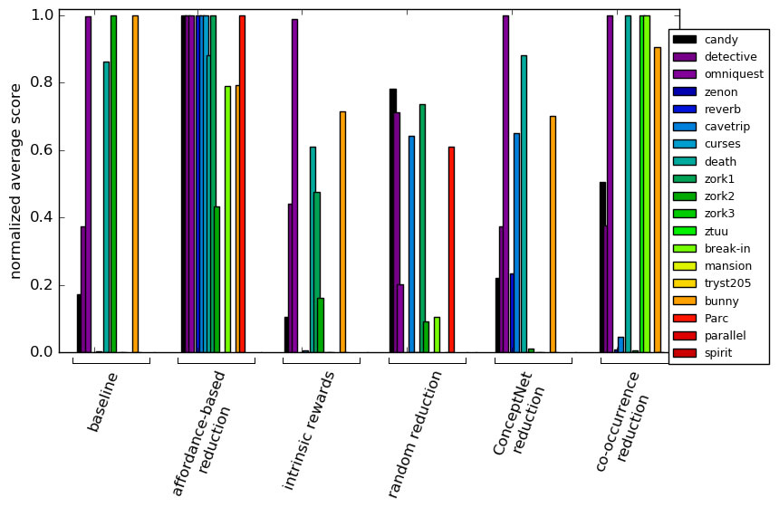
Yes.
Notes:
Each of these bars represents a game. Using game score as an estimator of quality, we see that affordance reduction performed better than four other ways of reducing the size of the agent’s search space.

Slide 42

Conclusion
We can treat a text corpus as a common sense knowledge base.
Notes:
We can extract affordances from unstructured text via word vectors.
These affordances are high-quality enough to improve agent performance on complex learning tasks.
Search space reduction is vital because the real world is complicated and robots break easily.

Slide 43
Conclusion
This knowledge significantly improves agent performance on linguistic reasoning tasks.
Notes:
We can extract affordances from unstructured text via word vectors.
These affordances are high-quality enough to improve agent performance on complex learning tasks.
Search space reduction is vital because the real world is complicated and robots break easily.

Slide 44
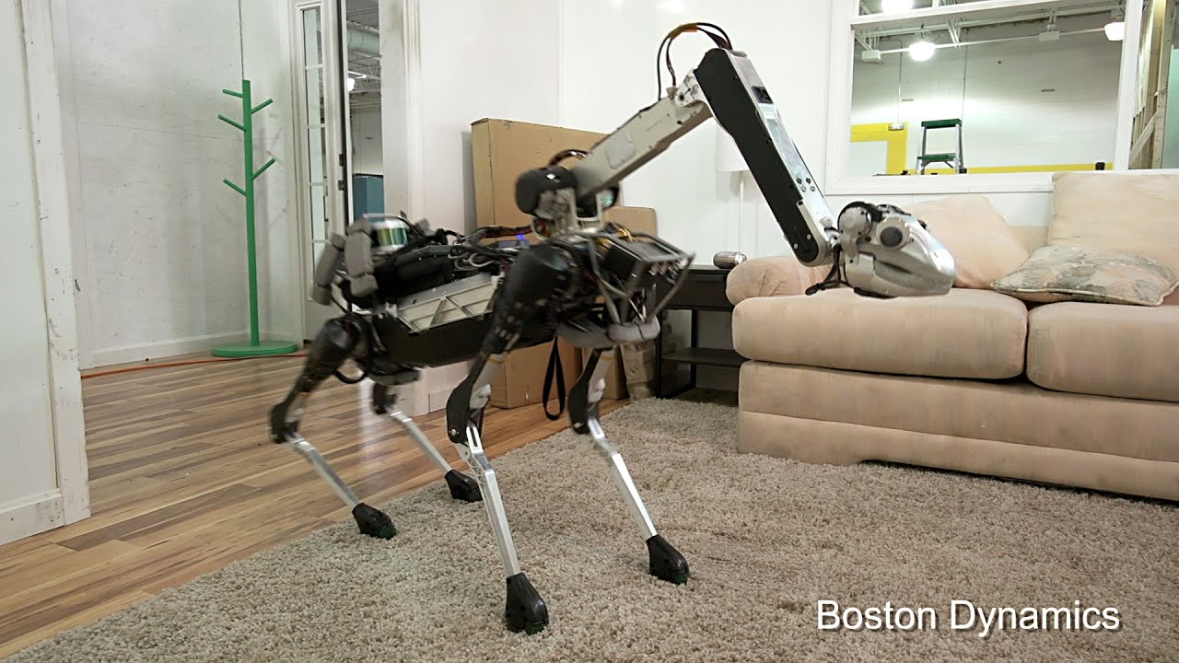
Notes:
For example: this plot shows a 100-dimensional semantic space projected down into just two dimensions: kitchen - refrigerator and kitchen - bathroom.
Household objects are grouped on the left, rooms of a house are found on the right,
And there’s a clear trend in the relationships between objects and the rooms in which they can be found.
And you can kind of imagine that, if we had all 100 dimensions instead of just two, we might see a single vector direction that encodes the relationship
Between an arbitrary household item and the room it belongs to.

Slide 45
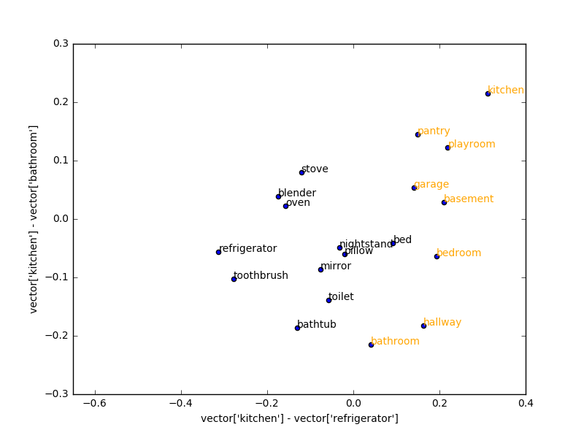
Structured Reduction
using relationships between rooms and objects
Notes:
For example: this plot shows a 100-dimensional semantic space projected down into just two dimensions: kitchen - refrigerator and kitchen - bathroom.
Household objects are grouped on the left, rooms of a house are found on the right,
And there’s a clear trend in the relationships between objects and the rooms in which they can be found.
And you can kind of imagine that, if we had all 100 dimensions instead of just two, we might see a single vector direction that encodes the relationship
Between an arbitrary household item and the room it belongs to.

Slide 46

Where can objects be found?
A
B
toothbrush → bathroom
refrigerator → kitchen
toaster → kitchen
potatoes → cellar
clothes → closet
D
C
milk
Harvesting Common-sense Knowledge for Robotics from Uncurated Text Corpora by Nancy Fulda, Nathan Tibbets, Zachary Brown and David Wingate, published in the first Conference on Robot Learning (CoRL), 2017.
Notes:
So let’s apply this idea to a classic robotics problem: Where’s the milk? My human just asked me to bring him some milk. Where can I find it?
We start with a list of 5-10 known examples - maybe these were provided by a human or maybe we learned them through trial and error
(They could even be seeded from a known curated system like KnowRob or ConceptNet)
- but we now want to generalize them to every other household object.
We average the vector differences between the items in column A and column B to obtain a prototypical relationship vector.
The naive hope is that if we add this vector to a new word C - in this case, milk - then the resulting point D
Will be close to the answers we’re looking for, and a simple nearest-neighbor search in the vicinity of D will give you a prioritized list of responses.

Slide 47
unpasteurized
D
coffee
C
milk
bread
meat
Harvesting Common-sense Knowledge for Robotics from Uncurated Text Corpora by Nancy Fulda, Nathan Tibbets, Zachary Brown and David Wingate, published in the first Conference on Robot Learning (CoRL), 2017.
Notes:
A say naive hope because this method doesn’t actually work very well. This approach works well for one-to-one queries between certain groups of words. But when we apply
It to more challenging many-to-many relationships, something very odd happens.
We get words that are related to the source word C of our analogical relation: coffee, bread, meat, unpasteurized - these are all food terms,
not rooms at all.

Slide 48
1 milk
2 coffee
3 bread
4 meat
5 unpasteurized
.
.
.
34 kitchen
?
unpasteurized
milk
D
coffee
C
milk
bread
meat
Harvesting Common-sense Knowledge for Robotics from Uncurated Text Corpora by Nancy Fulda, Nathan Tibbets, Zachary Brown and David Wingate, published in the first Conference on Robot Learning (CoRL), 2017.
Notes:
The closest word to our target point D, our top-ranked response - is the very word we started out with.
And the answer we’re looking for - kitchen - doesn’t show up until word #34
What’s going on?
There are two factors at work.
First, the embedding space we’re working with is extremely sparse. And because the canonical analogy vector is designed to eliminate non-essential variation, many of its component dimensions cancel out or reduce in size during the averaging process. So while we had initially supposed that the space looks like this:

Slide 49
1 milk
2 coffee
3 bread
4 meat
5 unpasteurized
.
.
.
34 kitchen
unpasteurized
milk
coffee
bread
meat
Harvesting Common-sense Knowledge for Robotics from Uncurated Text Corpora by Nancy Fulda, Nathan Tibbets, Zachary Brown and David Wingate, published in the first Conference on Robot Learning (CoRL), 2017.
Notes:
It’s really more like this. In many cases, the length of the canonical vector is smaller than the distance between a word and its nearest neighbor.

Slide 50
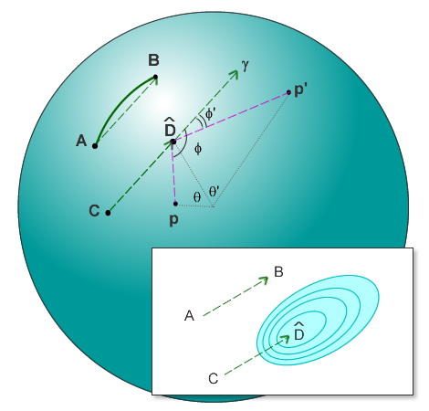
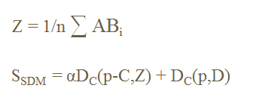
Our contribution:
Directional Scoring
Harvesting Common-sense Knowledge for Robotics from Uncurated Text Corpora by Nancy Fulda, Nathan Tibbets, Zachary Brown and David Wingate, published in the first Conference on Robot Learning (CoRL), 2017.
Notes:
This brings us to our contribution, a method of finding the words we’re actually looking for.
We’ve applied a directional scoring mechanism using a weighted average of distance and direction.
Each candidate point p is evaluated, not only based on its Euclidean distance from the offset point, but also based on the size of angle phi.

Slide 51
1 kitchen
2 cellar
3 milk
4 coffee
5 bedroom
6 bathroom
7 pantry
unpasteurized
cellar
kitchen
milk
pantry
coffee
bread
meat
Harvesting Common-sense Knowledge for Robotics from Uncurated Text Corpora by Nancy Fulda, Nathan Tibbets, Zachary Brown and David Wingate, published in the first Conference on Robot Learning (CoRL), 2017.
Notes:
The result is a scoring method that prioritizes words that lie along the extension of the analogical offset vector.
When we apply this method to our previous example, our top-scoring result becomes kitchen, the next-most-likely answer is cellar,
milk and coffee come next, and and pantry comes in at a respectable ranking or #7

Slide 52
Reasoning tasks faced by autonomous systems
Planning: How do I get to Hawaii?
1. airplane, 2. truck, 3. speedboat
Reasoning: Where does a cushion belong?
1. tent, 2. fireplace, 3. patio
Classification: Is this item trash?
dust → yes
shavings → yes
apple → no
Notes:
Let’s go back to those three examples from the beginning.
Key advantage - this is all extracted from a single, general-purpose set of word embeddings. Which means that if new needs arise at runtime, the system can immediately query the database and
Get reasonable results, so long as a human collaborator provides a set of example queries and answers.

Slide 53
Ok, but what’s next?

Slide 54

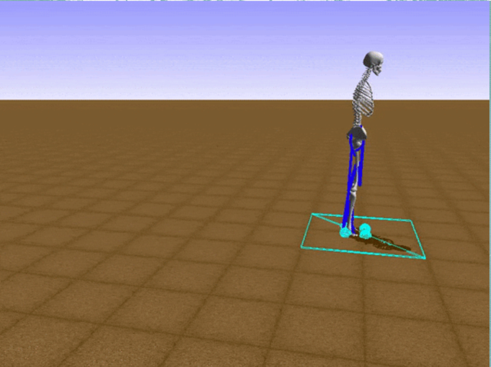
image from becominghuman.ai
image from deepsense.ai
Getting it Right the Fourth Time: Goal-driven Behavior Using Vector Space Models
by Nancy Fulda, Benjamin Murdoch and Daniel Ricks, in the proceedings of the IEEE 18th World Symposium on Applied Machine Intelligence and Informatics (SAMI), 2020
Notes:
Now, reinforcement learning is really great - it’s learned a lot of cool stuff. BUT.

Slide 55

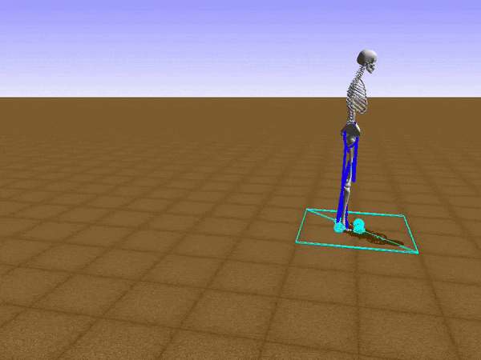
image from becominghuman.ai
image from deepsense.ai
Getting it Right the Fourth Time: Goal-driven Behavior Using Vector Space Models
by Nancy Fulda, Benjamin Murdoch and Daniel Ricks, in the proceedings of the IEEE 18th World Symposium on Applied Machine Intelligence and Informatics (SAMI), 2020
Notes:
Now, reinforcement learning is really great - it’s learned a lot of cool stuff. BUT.

Slide 56
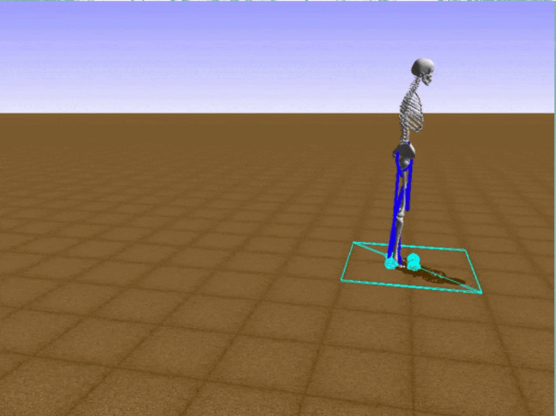

One step at
a time!
image from deepsense.ai
Getting it Right the Fourth Time: Goal-driven Behavior Using Vector Space Models
by Nancy Fulda, Benjamin Murdoch and Daniel Ricks, in the proceedings of the IEEE 18th World Symposium on Applied Machine Intelligence and Informatics (SAMI), 2020
Notes:
Now, reinforcement learning is really great - it’s learned a lot of cool stuff. BUT.

Slide 57
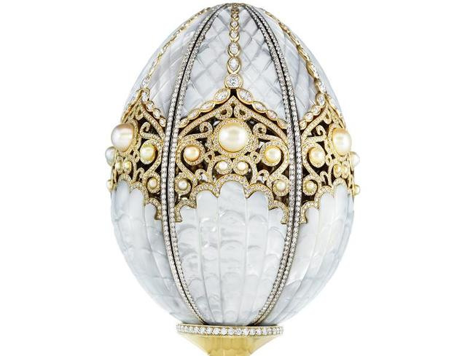
Consumable rewards
Faberge pearl Imperial egg
Promotional photo February 2015
Notes:
What do I mean by that? Well in Zork I you can earn five points by climbing a tree an acquiring a little jeweled egg. Almost every agent architecture I’ve seen has managed to do that. But once the egg is in your pocket, it can’t be fetched from the tree anymore. (not even if you put it back and try to pick it up again.) You only get the points once per game.

Slide 58
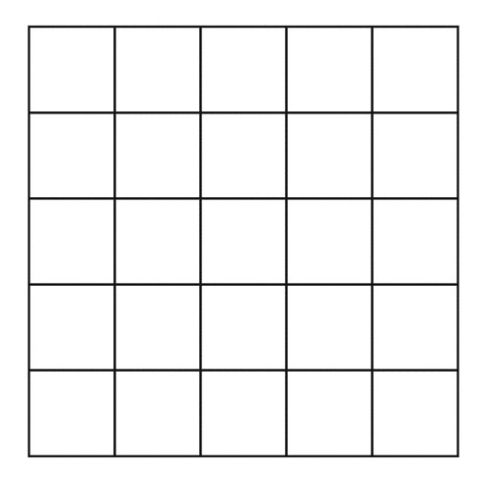
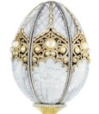
Notes:
What does this mean for agents who model their environment or try to learn a policy based on environmental rewards?

Slide 61
Notes:
What does this mean for agents who model their environment or try to learn a policy based on environmental rewards?

Slide 63
Notes:
And now, when the game resets and the agent tries to apply its learned policy – it turns out, it hasn’t really learned anything at all.

Slide 64

√ achieved goal 1
√ achieved goal 1
√ achieved goal 1
achieved goal 2
√ achieved goal 2
√ achieved goal 2
achieved goal 3
achieved goal 3
√ achieved goal 3
achieved goal 1
achieved goal 1
achieved goal 1
√ achieved goal 2
√ achieved goal 2
achieved goal 2
√ achieved goal 3
achieved goal 3
achieved goal 3
Notes:
One approach is to include the current game score, or a list of rewards received so far, in the agent’s state space representation, but that’s going to increase the agent’s search space by orders of magnitude, and it’s also going to inhibit generalization in cases where rewards aren’t directly dependent on each other. In Zork, for example, the agent would now have to figure out how to get inside the white house twice: once if it has possession of the egg, and once if it hasn’t.

Slide 65

max
avg
Notes:
Another approach might be to use policy learning variants that remember the maximum score ever attained for a specific action, rather than just the statistical average.

Slide 66

Notes:
But I think what we really need in this case is a paradigm shift. We need new ways of thinking about agents, policies, and state space representations.
How are we going to solve this problem?
But, language does give us some key advantages:
For example, symbol grounding: we don’t have to ground words into tangible experiences; we just have to ground them with respect to other words

Slide 67

Getting from Goals to Actions
Climb the tree!
Getting it Right the Fourth Time: Goal-driven Behavior Using Vector Space Models
by Nancy Fulda, Benjamin Murdoch and Daniel Ricks, in the proceedings of the IEEE 18th World Symposium on Applied Machine Intelligence and Informatics (SAMI), 2020

Slide 68

Climb the
tree!
Getting it Right the Fourth Time: Goal-driven Behavior Using Vector Space Models
by Nancy Fulda, Benjamin Murdoch and Daniel Ricks, in the proceedings of the IEEE 18th World Symposium on Applied Machine Intelligence and Informatics (SAMI), 2020
Notes:
We can use these discovered actions to guide the agent’s exploration so that they try the smartest actions first. Maybe we can’t get it right on the first try. But can we get it right on the third try? Or the fourth, or the fifth?

Slide 69
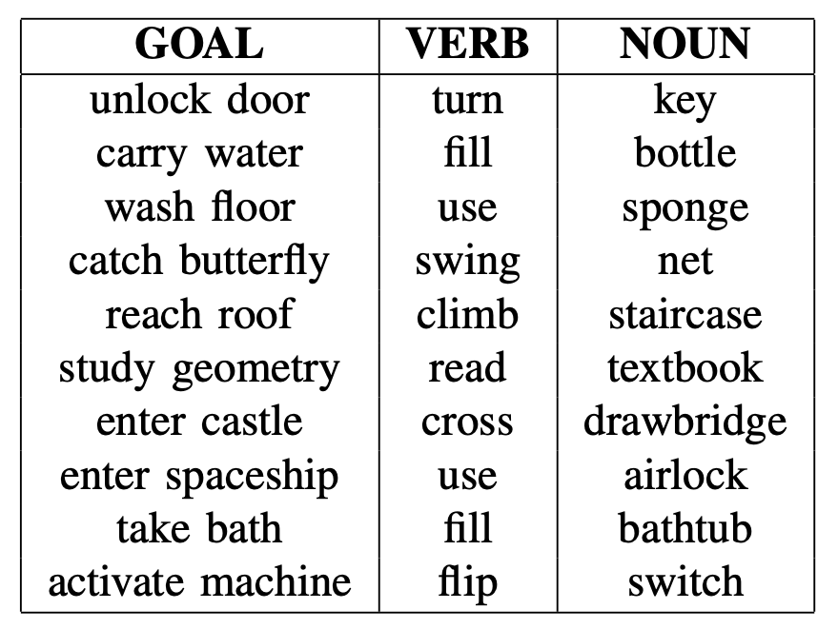
Getting it Right the Fourth Time: Goal-driven Behavior Using Vector Space Models
by Nancy Fulda, Benjamin Murdoch and Daniel Ricks, in the proceedings of the IEEE 18th World Symposium on Applied Machine Intelligence and Informatics (SAMI), 2020

Slide 70
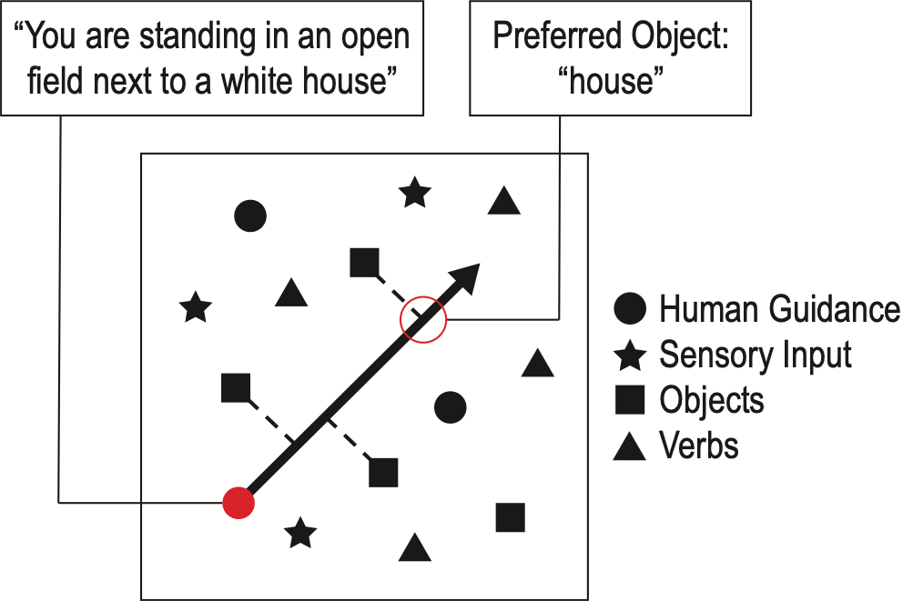
Enter buildings
Preferred object:
“door”
open
Getting it Right the Fourth Time: Goal-driven Behavior Using Vector Space Models
by Nancy Fulda, Benjamin Murdoch and Daniel Ricks, in the proceedings of the IEEE 18th World Symposium on Applied Machine Intelligence and Informatics (SAMI), 2020

Slide 71
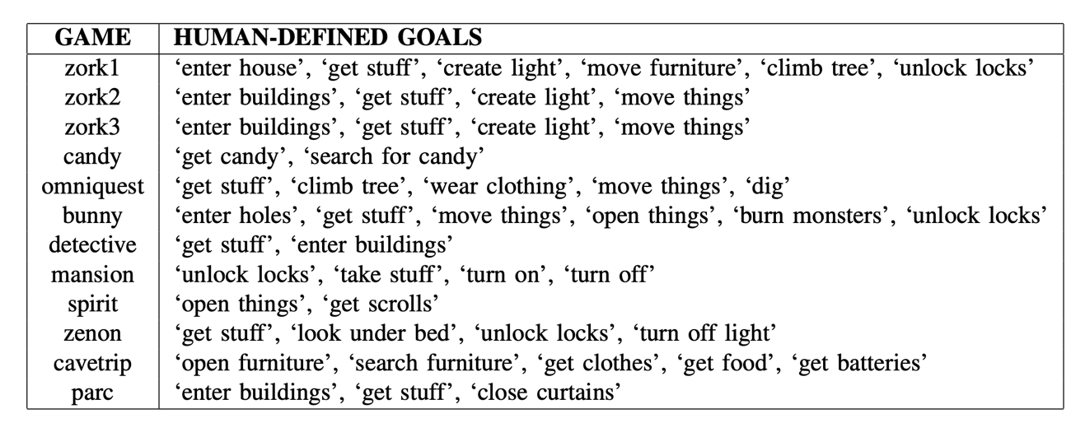
Getting it Right the Fourth Time: Goal-driven Behavior Using Vector Space Models
by Nancy Fulda, Benjamin Murdoch and Daniel Ricks, in the proceedings of the IEEE 18th World Symposium on Applied Machine Intelligence and Informatics (SAMI), 2020

Slide 72
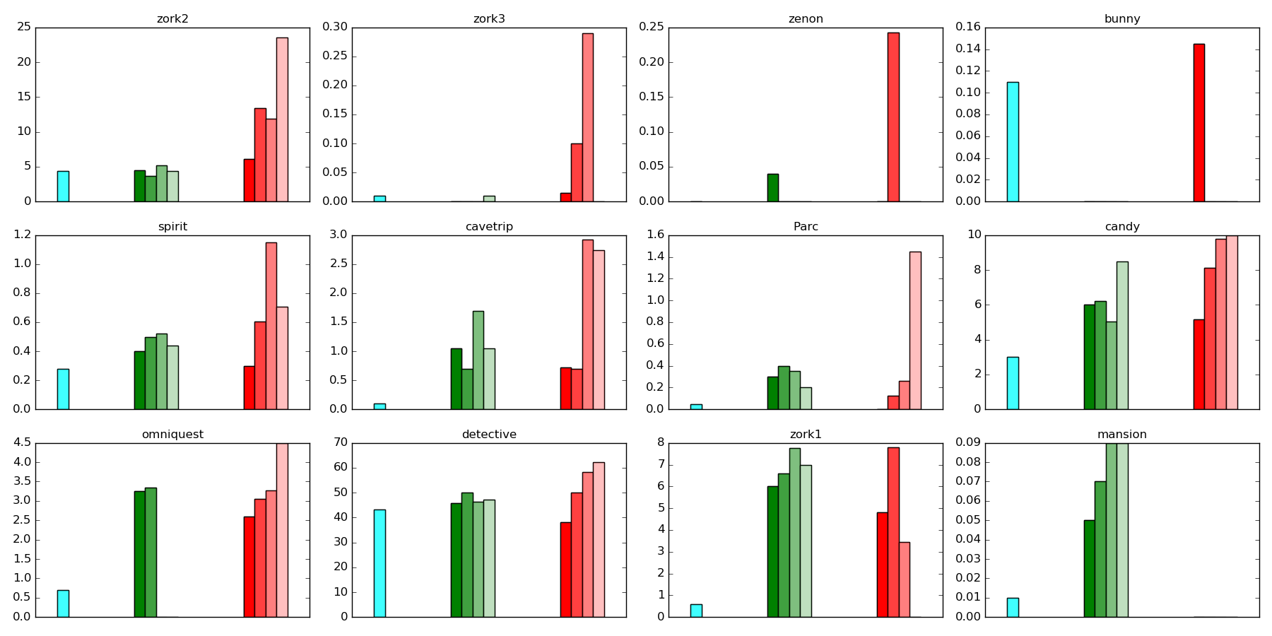
Getting it Right the Fourth Time: Goal-driven Behavior Using Vector Space Models
by Nancy Fulda, Benjamin Murdoch and Daniel Ricks, in the proceedings of the IEEE 18th World Symposium on Applied Machine Intelligence and Informatics (SAMI), 2020

Slide 73
Does it matter which
goals we give it?

Slide 74
Yes.

Slide 75
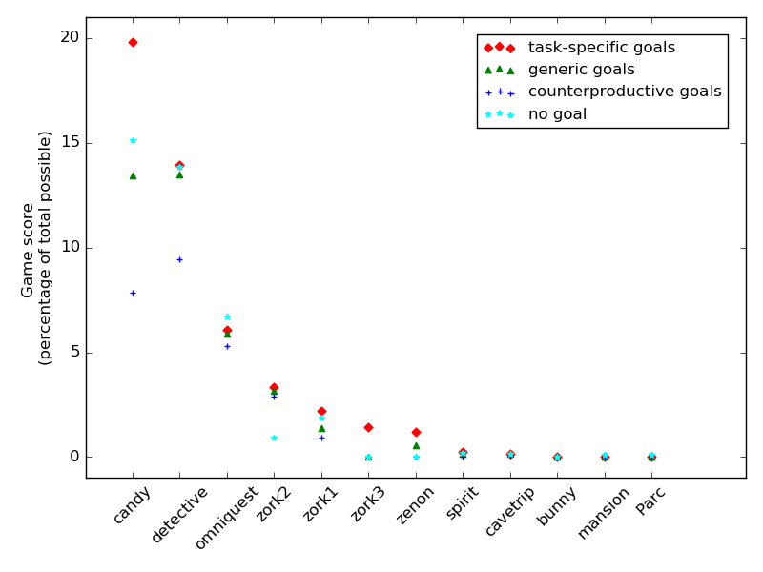

Slide 76

‘enter buildings’, ‘get stuff’, ‘move things’, ‘open things’, ‘search furniture’, ‘attack enemies’, ‘unlock locks’.
‘close things’, ‘drop stuff’, ‘eat penguins’, ‘murder blueberries’

Slide 77

Conclusion
Human guidance can help agents find the right actions faster.

Slide 78
Conclusion
This speeds the learning process and improves overall results

Slide 79
Conclusion
(Also, playing with language is really fun.)

Slide 80
Questions?
BYU DRAGN Labs
DRAGN.ai
Notes:
Thank you for your time. We have a few minutes for questions.

Slide 81
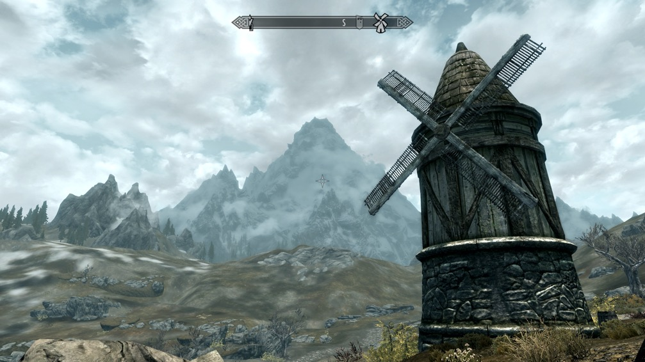

Threat, Explore, Barter, Puzzle
A Semantically-Informed Algorithm
for Extracting Interaction Modes
Nancy Fulda
Daniel Ricks
Ben Murdoch
David Wingate
BYU PCCL

Slide 82
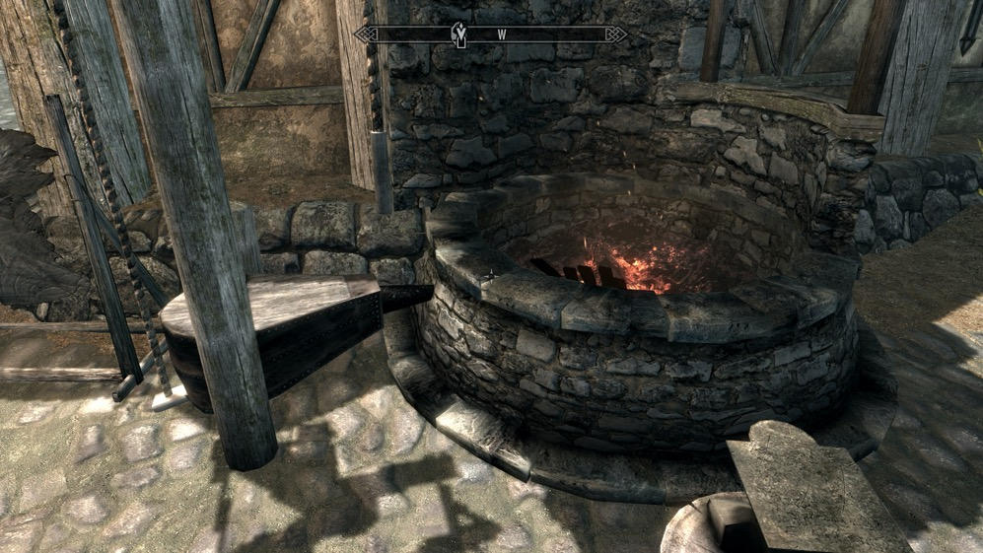
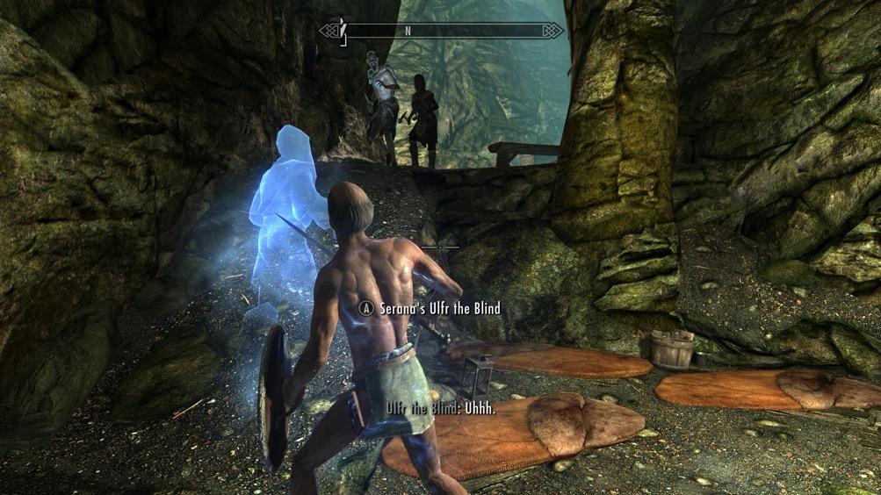
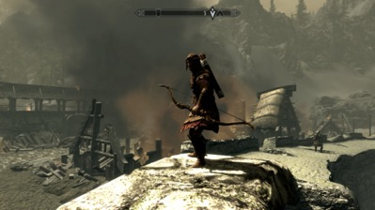
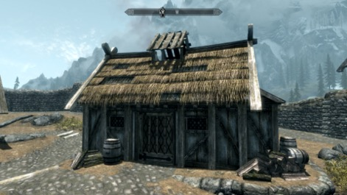
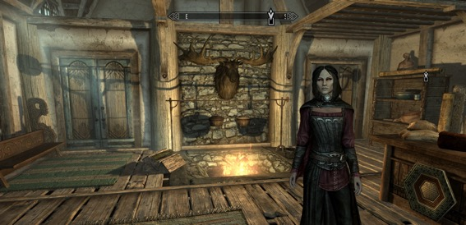
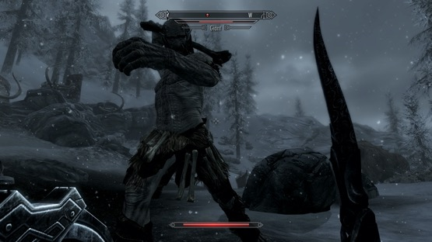
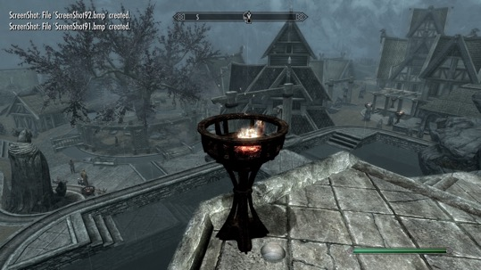
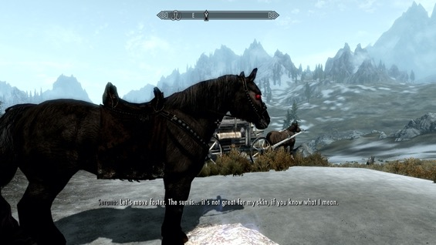
Notes:
Given a screenshot of the game, we want to be able to determine quickly and easily which interaction mode is evoked, and hence which subset of behaviors is most logical.
Evokes behaviors and to a certain extent constrains them

Slide 83

Interaction Mode
The set of player actions that would be reasonable to execute in the given situation.
Notes:
The current situation evokes a specific and immediate response.

Slide 84
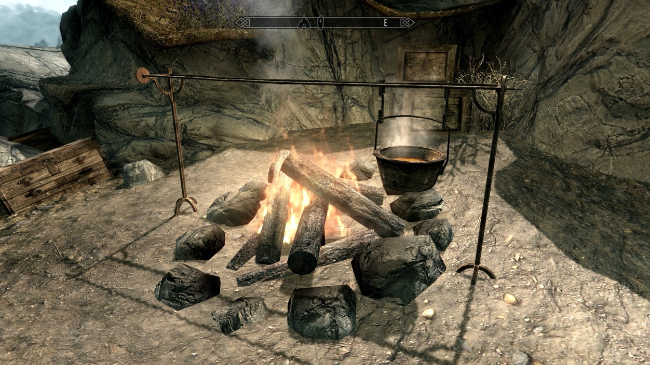
Interaction Modes
The set of player actions that would be reasonable to execute in the given situation.
Notes:
Similarly, in this scene, it wouldn’t make much sense to attack the firepit or try to barter with the rock. Instead it invites the player to manipulate objects, perhaps to take the soup pot or douse the fire, or open the wooden chest in the background.

Slide 85
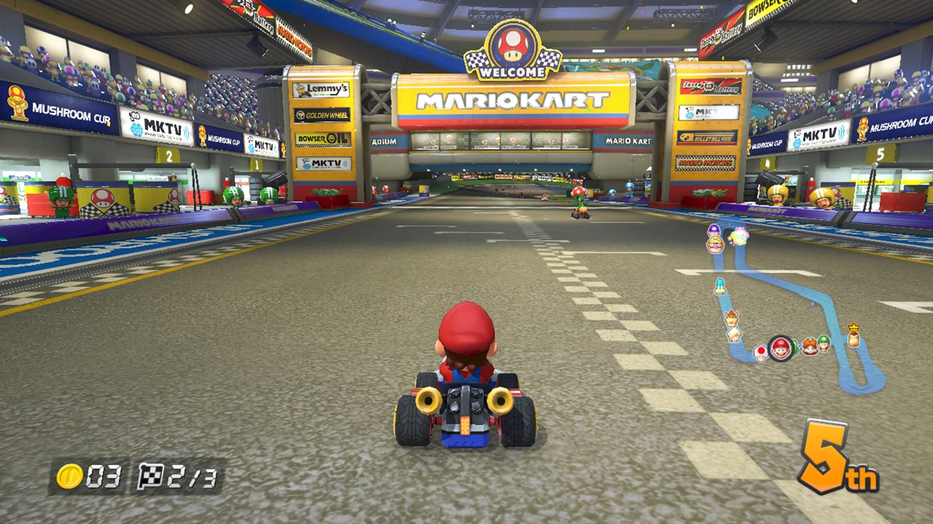
Interaction Modes
Notes:
We believe that all, or nearly all, games have these types of interaction modes. In Mario Kart, sometimes you need to jump and shoot, other times you need to put on the breaks.

Slide 86
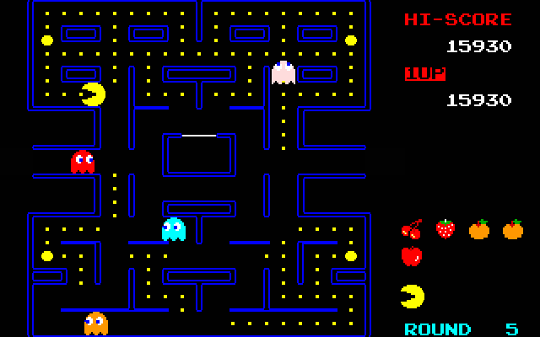
Interaction Modes
Notes:
In Pac Man, there is a time to eat ghosts and a time to flee from ghosts in order to avoid being eaten…
And we feel that distinguishing modes is important both from a game design perspective and from an artificial agent perspective. One could even imagine someday mapping a game based, not on its geographic structures or storyline, but instead based on the transitions between interaction modes, which could lead to some interesting new insights.

Slide 87
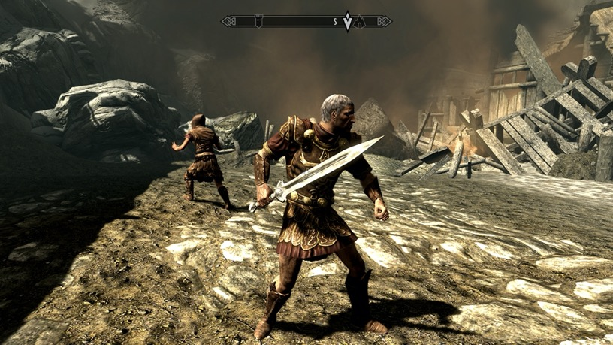
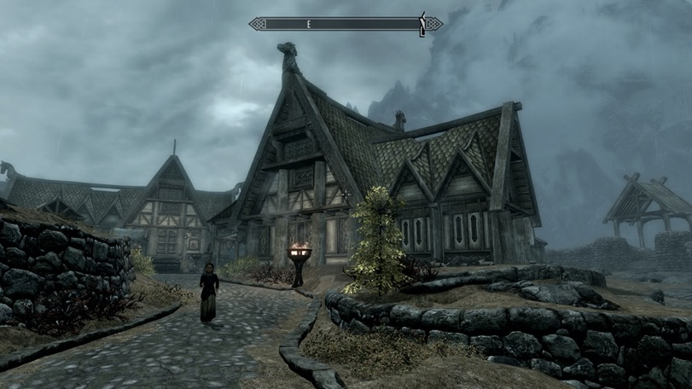
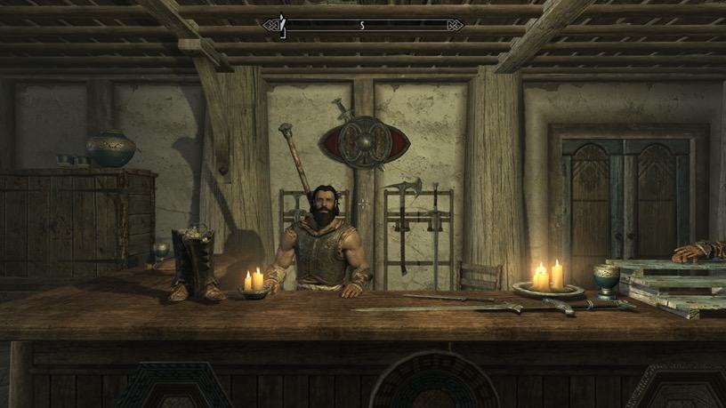
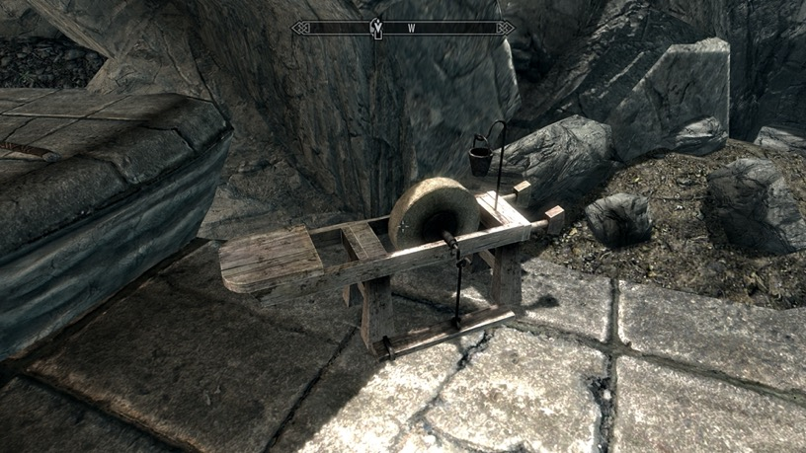
Threat
Explore
Barter
Puzzle
Notes:
In the case of SkyRim (our test environment, by Bethesda SoftWorks) we identified four high-level interaction modes that we’d like to distinguish.

Slide 88
AEGIM
Algorithm for the Extraction of Game Interaction Modes
Game State
(pixels)
Caption generator
Interaction
mode
Text
Classifier
Notes:
Why go through text first? Because when we classify interaction modes, we’re dealing with concept space. An interaction mode isn’t just about identifying what’s present, it’s about understanding what those objects mean and how they can be interacted with. Those types of ideas are best understood in language space, not in pixel space.
The key idea is to see whether we can leverage

Slide 89
Why go through text?
avoids retraining
gestalt representation
common-sense reasoning
Notes:
We’ve already got systems that can go from pixels to text. And as we’ll see in a moment, going from text to interaction modes can be accomplished fairly easily. Gestalt representation – a hammer is not inherently threatening, nor is a man who looks angry. But an angry man with a hammer is cause for immediate concern.
Common-sense reasoning: A cooking pot can be lifted. A key can be turned.
It’s this cognitive knowledge that we hope to leverage.

Slide 90

Explore
Tunnel => traversed
Notes:
These kinds of relationships are difficult to learn from images alone, but they emerge naturally in models trained on text corpora. For example, some of you may have heard of the word2vec algorithm.

Slide 91

Woman => speak
Puzzle, Explore
Plant => harvested

Slide 92


cat | dog | king | Spain
-.021 | 0.137 | -.211 | -.004
0.184 | 0.915 | -.002 | 0.102
0.624 | 0.033 | 0.039 | -.016
-0.06 | -.162 | 0.043 | -.083
0.017 | 0.158 | -.036 | -.155
Notes:
We’re using sentence-level representations, but the process is a bit easier to explain at the word level, so let me walk you through that part first.
Well, it starts with Wikipedia – all 2.9 billion words of it

Slide 93

Image from https://medium.com/botsupply/generative-model-chatbots-e422ab08461e

Slide 94
GLoVE BoW
GPT-2
InferSent
Transformer-XL
FastText BoW
BERT
Word2vec BoW
Universal sentence encoder
CTRL
ConceptNet Numberbatch
BoW
Skip-thought
Meena

Slide 95
-0.06682738 0.09215793 0.17144153 0.02722136 0.11558430 -0.08248196 0.11843809 -0.12511319 0.05137921 0.11610924 0.02890519 0.05781341 0.00060934 0.08721734 -0.06214677 -0.01641109 -0.09956811 0.02940805 -0.00749719 -0.04193981 -0.00124285 -0.13911526 -0.08455686 -0.03962927 -0.07736503 0.06175299
-0.21322276
-0.00232553
0.02538056
0.03806305
-0.02614621
-0.13762052
0.12779924
-0.14959556
-0.03518025
0.18830119
-0.07647780
-0.06677846
0.16195294
0.03757538
-0.08233782
-0.06089141
-0.18787964
-0.12672471
-0.14574859
0.05483447
0.14443699
-0.05003889
0.13691758
-0.11218044
-0.02321893
-0.04197759
0.07855503
0.15160337
-0.03754051
0.09770505
0.03732581
0.09888028
-0.02764712
0.20546009
0.22924256
0.09451764
0.09711117
-0.03715874
0.07227404
-0.08714961
-0.04388496
-0.12194700
-0.04891750
-0.00504802
-0.00460029
0.02029388
-0.10900176
-0.05783204
0.09538368
-0.06989353
0.05746548
-0.18247047
0.02190599
0.10686026
0.01007701
0.03129383
-0.12247751
0.07310284
-0.12459797
-0.12183627
0.08131812
-0.15289426
-0.14013295
0.14242208
0.03775534
-0.15742442
0.03032710
-0.18968104
-0.06007691 -0.12675105
0.04533792
0.09973429
-0.11974225
0.05186511
-0.10171629
-0.04816883
king
– man
+ woman =
queen

Slide 96
-0.06682738 0.09215793 0.17144153 0.02722136 0.11558430 -0.08248196 0.11843809 -0.12511319 0.05137921 0.11610924 0.02890519 0.05781341 0.00060934 0.08721734 -0.06214677 -0.01641109 -0.09956811 0.02940805 -0.00749719 -0.04193981 -0.00124285 -0.13911526 -0.08455686 -0.03962927 -0.07736503 0.06175299
-0.21322276
-0.00232553
0.02538056
0.03806305
-0.02614621
-0.13762052
0.12779924
-0.14959556
-0.03518025
0.18830119
-0.07647780
-0.06677846
0.16195294
0.03757538
-0.08233782
-0.06089141
-0.18787964
-0.12672471
-0.14574859
0.05483447
0.14443699
-0.05003889
0.13691758
-0.11218044
-0.02321893
-0.04197759
0.07855503
0.15160337
-0.03754051
0.09770505
0.03732581
0.09888028
-0.02764712
0.20546009
0.22924256
0.09451764
0.09711117
-0.03715874
0.07227404
-0.08714961
-0.04388496
-0.12194700
-0.04891750
-0.00504802
-0.00460029
0.02029388
-0.10900176
-0.05783204
0.09538368
-0.06989353
0.05746548
-0.18247047
0.02190599
0.10686026
0.01007701
0.03129383
-0.12247751
0.07310284
-0.12459797
-0.12183627
0.08131812
-0.15289426
-0.14013295
0.14242208
0.03775534
-0.15742442
0.03032710
-0.18968104
-0.06007691 -0.12675105
0.04533792
0.09973429
-0.11974225
0.05186511
-0.10171629
-0.04816883
king
– man
+ woman =
queen
Spain
– Madrid
+ Paris =
France
Notes:
We’re not actually using word2vec, or not directly. We’re using the same idea trained at the sentence level rather than at the word level, but more on that later…

Slide 97
AEGIM
Algorithm for the Extraction of Game Interaction Modes
Game State
(pixels)
Caption generator
Interaction
mode
Text
Classifier
Notes:
Why go through text first? Because when we classify interaction modes, we’re dealing with concept space. An interaction mode isn’t just about identifying what’s present, it’s about understanding what those objects mean and how they can be interacted with. Those types of ideas are best understood in language space, not in pixel space.
The key idea is to see whether we can leverage

Slide 98




Slide 99

Notes:
The first part of this is fairly easy – caption generation.

Slide 100


Slide 101



Slide 102
Never played Skyrim
No knowledge of algorithm
Asked to ‘give a one-sentence description of each picture’.
Notes:
As a side note, it was fascinating to see how much information her captions inserted that wasn’t actually a part of the image. For example, she’d say, “A woman in front of HER house”

Slide 103



AEGIM
Algorithm for the Extraction of Game Interaction Modes
Game State
(pixels)
Caption generator
Interaction
mode
Text
Classifier
Notes:
Why go through text first? Because when we classify interaction modes, we’re dealing with concept space. An interaction mode isn’t just about identifying what’s present, it’s about understanding what those objects mean and how they can be interacted with. Those types of ideas are best understood in language space, not in pixel space.
The key idea is to see whether we can leverage

Slide 104
AEGIM
Algorithm for the Extraction of Game Interaction Modes
Game State
(pixels)
Caption generator
Interaction
mode
Text
Classifier
Notes:
Why go through text first? Because when we classify interaction modes, we’re dealing with concept space. An interaction mode isn’t just about identifying what’s present, it’s about understanding what those objects mean and how they can be interacted with. Those types of ideas are best understood in language space, not in pixel space.
The key idea is to see whether we can leverage

Slide 105

Classifier

Slide 106
Classifier
Sentence-level word representations trained based on context
4800 dimensions
Generalizes to previously unseen data
Notes:
In this 4800-dimensional space, we defined a couple of extremely simple cluster-based classifiers. The objective was not to create a final algorithm ready for deployment, but to analyze the inherent potential in this method of information extraction – we anticipate that future researchers will be able to combine these ideas with more sophisticated categorization methods to achieve state of the art results.

Slide 107
Classifier
Sentence-level word representations trained based on context
4800 dimensions
Generalizes to previously unseen data
Distance to Centroid
Nearest-neighbor
Notes:
In this 4800-dimensional space, we defined a couple of extremely simple cluster-based classifiers. The objective was not to create a final algorithm ready for deployment, but to analyze the inherent potential in this method of information extraction – we anticipate that future researchers will be able to combine these ideas with more sophisticated categorization methods to achieve state of the art results.

Slide 108
Skip-thought vectors
Sentence-level word representations trained based on context
4800 dimensions
Generalizes to previously unseen data
Threat: “You see a soldier holding a sword”
Explore: “A towering windmill sits on the hillside”
Barter: “The shopkeeper looks at you expectantly”
Puzzle: “The lever clicks into place.”
Notes:
In this 4800-dimensional space, we defined a couple of extremely simple cluster-based classifiers. The objective was not to create a final algorithm ready for deployment, but to analyze the inherent potential in this method of information extraction – we anticipate that future researchers will be able to combine these ideas with more sophisticated categorization methods to achieve state of the art results.

Slide 109
AEGIM
Algorithm for the Extraction of Game Interaction Modes
Game State
(pixels)
Caption generator
Interaction
mode
Text
Classifier
Skipthought vectors
Bag-of-words
Nearest-centroid
Nearest-exemplar
Notes:
What did work quite well was to evaluate each interaction mode on its own, rather than attempting to select between four categories. We also created a baseline agent that attempted to accomplish the same task, but without using word representations. Instead, it used a keyword system and searched for trigger words within the caption text.

Slide 110

Preliminary Results
Classification Accuracy
Binary classifiers for each interaction mode
Human: 75%
Notes:
Constant baseline – how well could we do if we cheated? What if the baseline had some a priori knowledge of the dataset, how well could it do by simply always predicting the most common response? As you can see, we don'

Slide 111

Preliminary Results
Exact Matches
Binary classifiers for each interaction mode
Human: 36.4%
Notes:
No false positives or false negatives
Here, the constant baseline totally kicks our pants, because it knows something our algorithm doesn’t – most of the time, only one of the four categories is active at a time. So let’s try to match that…

Slide 112

Preliminary Results
Partial Matches
Nearest-neighbor classifier
Notes:
Partial matches – we treat any of the human-provided categorizations as valid. So the agent uses a nearest-neighbor
Human performance is twice as good as random, which only guesses the right category out of the four 25% of the time.
Nearest-neighbor functions much better than nearest-centroid approach.
So there’s definitely some signal here – without any kind of training and with only 10 examples of each category, we’re doing about twice as well as a random baseline. And as we’d expect, the human-generated captions are doing better, but not by much. Which means that if we can learn to extract the information well, automated caption generators will probably do ok.

Slide 113

Notes:
So let’s look at some specific cases
Overall AEGIM correctly identifies exploration
scenes regardless of captioning method, perhaps because
Clarifai and CaptionBot both detect landscape elements like
hills, clouds, and buildings.
tions

Slide 114

Notes:
This is one of the few combat images that was even moderately well-captioned by the automated systems.
(Scenes with similar elements were described as ‘A group of people jumping’ or ‘a young man practicing his tricks on his
skateboard’. And dragons are often mistaken for birds.)

Slide 115

Notes:
It is not difficult to see why CaptionBot mistook
the image for a clock. Less obvious is why AEGIM does not
consider the clock a puzzle item to be interacted with.

Slide 116

Notes:
In this case the human captioner’s commentary on
the shopkeeper’s physique obscured the correct classification.
AEGIM correctly returns the interaction mode ‘Barter’
when given the input text ‘A blacksmith sitting in his shop’.

Slide 117
Sentence embeddings
Semantic absorption - The amount of semantic
information encoded within an embedding space

Slide 118

Sentence embeddings
Image from https://towardsdatascience.com/whats-new-in-deep-learning-research-inside-google-s-semantic-experiences-4536d57c685

Slide 119





System architecture
What is your name?
My name is Charles. I’m from New Jersey. I love New Jersey!
I hate New Jersey.
Oh, me too! The weather there is terrible!
What was your name again?
Jessica!
Notes:
Why have a knowledge graph at all? Why not just use a generative model and let the neural networks produce all the text? Well, short and simple, because it doesn’t work.
Not only

Slide 120

Better sentence embeddings
Cosine distances between paired sentences
Notes:
Cosine distance is defined as 1 minus the dot product for normalized vectors.

Slide 121

Better sentence embeddings
Cosine distances between paired sentences
Notes:
Cosine distance is defined as 1 minus the dot product for normalized vectors.

Slide 122




Why do we care?
Simplified interfaces
Hands-free control
Accessibility
Notes:
Well, aside from the fact that it would be great if you could get your automated voice assistant to actually play the right song…
If we had a system capable of this kind of common-sense inference, what would that mean?
Well, In addition to the fact that more complex tasks could be performed with less training…
We’d also have better hands-free interfaces (for vehicles and or other situations)
But for me, the most exciting aspect of this idea is its potential to improve access to sophisticated technology. As of 2015, 17% of the world was illiterate. That’s 775 million people (⅔ women) around the globe who can’t use search engines, educate themselves through online classes, or otherwise access the vast wealth of the information superhighway that you and I tap into without thinking, every day. In addition to that group, we have a large percentage of elderly who can’t easily read computer screens or whose hands tremble too much to use a computer keyboard - and then there’s an even larger group of people who, while nominally literate, aren’t computer literate, and struggle to interface with systems that rely on keyboards, command menus, and obscure buttons whose meanings often aren’t adequately labeled.
If we can create software that interacts with humans on our own terms - using the words, language and colloquialisms that humans are naturally proficient at - we can potentially extend access to technology to some of the most disadvantaged groups on the globe.
Now, you’re sitting here listening to me and you’re thinking, Well, that sounds great Nancy, but how do you intend to actually DO that?

Slide 123
How can we increase semantic absorption?
Notes:
So if all this is possible with flawed embeddings… what could we do if the embeddings were better structured?
And if we were going to make better embeddings, what would they look like?

Slide 124

Better Sentence Embeddings
3x training tasks
2 x corpora
Reconstruction
Context prediction
Word prediction
Wikipedia
Toronto book corpus
You Are What You Read: The Effect of Corpus and Training Task on Semantic Absorption in Recurrent Neural Architectures by Nancy Fulda, published in the proceedings of the IEEE 18th World Symposium on Applied Machine Intelligence and Informatics (SAMI), 2020

Slide 125

Better Sentence Embeddings
You Are What You Read: The Effect of Corpus and Training Task on Semantic Absorption in Recurrent Neural Architectures by Nancy Fulda, published in the proceedings of the IEEE 18th World Symposium on Applied Machine Intelligence and Informatics (SAMI), 2020

Slide 126
Better Sentence Embeddings
You Are What You Read: The Effect of Corpus and Training Task on Semantic Absorption in Recurrent Neural Architectures by Nancy Fulda, published in the proceedings of the IEEE 18th World Symposium on Applied Machine Intelligence and Informatics (SAMI), 2020

Slide 127
Better Sentence Embeddings
Conclusions
More data is not always better
There is a complex interplay between training task and training corpus
When designing training curricula, proceed incrementally
You Are What You Read: The Effect of Corpus and Training Task on Semantic Absorption in Recurrent Neural Architectures by Nancy Fulda, published in the proceedings of the IEEE 18th World Symposium on Applied Machine Intelligence and Informatics (SAMI), 2020

Slide 128

Another chance to ask questions!
BYU DRAGN Labs
Notes:
Well, aside from the fact that it would be great if you could get your automated voice assistant to actually play the right song…
If we had a system capable of this kind of common-sense inference, what would that mean?
Well, In addition to the fact that more complex tasks could be performed with less training…
We’d also have better hands-free interfaces (for vehicles and or other situations)
But for me, the most exciting aspect of this idea is its potential to improve access to sophisticated technology. As of 2015, 17% of the world was illiterate. That’s 775 million people (⅔ women) around the globe who can’t use search engines, educate themselves through online classes, or otherwise access the vast wealth of the information superhighway that you and I tap into without thinking, every day. In addition to that group, we have a large percentage of elderly who can’t easily read computer screens or whose hands tremble too much to use a computer keyboard - and then there’s an even larger group of people who, while nominally literate, aren’t computer literate, and struggle to interface with systems that rely on keyboards, command menus, and obscure buttons whose meanings often aren’t adequately labeled.
If we can create software that interacts with humans on our own terms - using the words, language and colloquialisms that humans are naturally proficient at - we can potentially extend access to technology to some of the most disadvantaged groups on the globe.
Now, you’re sitting here listening to me and you’re thinking, Well, that sounds great Nancy, but how do you intend to actually DO that?

Slide 129


Slide 130

Conversational AI
WE BUILD CHATBOTS
Notes:
That’s our advisor in the back, the rest of us are students. I was the team lead, which means not only did I write the bulk of the funding proposal, but I also got to design the high-level architecture, manage the infrastructure pipeline that kept our bot live in the cloud, and oversee our communications with Amazon. I was also the person Amazon called when our bot started throwing insults at customers.

Slide 131


System architecture
Notes:
The reward for a well written proposal is a gargantuan task on a really tight schedule.

Slide 132


Alexa Prize 2018
Notes:
The reward for a well written proposal is a gargantuan task on a really tight schedule.

Slide 133

Alexa Prize 2018
Notes:
Why have a knowledge graph at all? Why not just use a generative model and let the neural networks produce all the text? Well, short and simple, because it doesn’t work.
Not only

Slide 134
System architecture
What is your name?
My name is Charles. I’m from New Jersey. I love New Jersey!
I hate New Jersey.
Oh, me too! The weather there is terrible!
What was your name again?
Jessica!
Notes:
Why have a knowledge graph at all? Why not just use a generative model and let the neural networks produce all the text? Well, short and simple, because it doesn’t work.
Not only

Slide 135

Knowledge Graph
Notes:
Property graph (as opposed to RDF framework) - Gremlin queries. Related ideas are kept close to one another via edges - by traversing edges, you can subtly shift the conversation from one topic to another.
But as always in artificial intelligence, you sometimes get more than you bargained for. In addition to really smooth conversational transitions like “Brandon Sanderson is a great author, have you read his book Warbreaker?”, we also got stuff like:

Slide 136

Response Generation
“Cat, that’s a gene, isn’t it?”
(CAT is a genetic codon for the amino acid histadine)
Notes:
Not only

Slide 137

Response Generation
“Do you consider cat to be a typical
example of the animal painting genre?”
“Cats” by Franz Marc
Notes:
So this is a classic case of the knowledge graph generators being too smart for their own good. We end up with something like an idiot savant who comes up with some really awesome ideas but has no concept of social appropriateness.
Not only

Slide 138

Response Generation
“I'm thinking I might also like alan tudyk
since alan tudyk was a voice actor in
moana and I like moana.”
(Alan Tudyk voiced HeiHei in Moana)

Slide 139

Conversational Scaffolding
Do you consider cats to be good pets?
I love cats! Have you ever owned one?
A cat is a small carnivorous mammal
Why do you say that you like cats?
Hey - why did the kitten cross the road?
I love cats! Have you ever owned one?
Notes:
We had several rankers, most of which I coded. But the conversational scaffolding ranker was by far my favorite, and in my opinion the most impactful.

Slide 140


Conversational Scaffolding
Will Myers
Tyler Etchart
Conversational Scaffolding: An Analogy-Based Approach to Response Prioritization in Open-Domain Dialogs
by Will Myers, Tyler Etchart, and Nancy Fulda, published in the proceedings of the twelfth International Conference on Agents and Artificial Intelligence, February 2020
Notes:
So we said, let’s take that same idea, and that same semantic structure, and let’s apply it to response ranking. Specifically, let’s use a scaffold corpus to embody the conversational patterns we want our bot to emulate.

Slide 141


Conversational Scaffolding
Conversational Scaffolding: An Analogy-Based Approach to Response Prioritization in Open-Domain Dialogs
by Will Myers, Tyler Etchart, and Nancy Fulda, published in the proceedings of the twelfth International Conference on Agents and Artificial Intelligence, February 2020
Notes:
So we said, let’s take that same idea, and that same semantic structure, and let’s apply it to response ranking. Specifically, let’s use a scaffold corpus to embody the conversational patterns we want our bot to emulate.

Slide 142

Naive Analogy
Conversational Scaffolding: An Analogy-Based Approach to Response Prioritization in Open-Domain Dialogs
by Will Myers, Tyler Etchart, and Nancy Fulda, published in the proceedings of the twelfth International Conference on Agents and Artificial Intelligence, February 2020
Notes:
We actually tested and compared three methods, but we’ll only go into one of them here.

Slide 143


Flow Vectors
Conversational Scaffolding: An Analogy-Based Approach to Response Prioritization in Open-Domain Dialogs
by Will Myers, Tyler Etchart, and Nancy Fulda, published in the proceedings of the twelfth International Conference on Agents and Artificial Intelligence, February 2020

Slide 144

Scattershot
Conversational Scaffolding: An Analogy-Based Approach to Response Prioritization in Open-Domain Dialogs
by Will Myers, Tyler Etchart, and Nancy Fulda, published in the proceedings of the twelfth International Conference on Agents and Artificial Intelligence, February 2020

Slide 145

Algorithms in the wild
Conversational Scaffolding: An Analogy-Based Approach to Response Prioritization in Open-Domain Dialogs
by Will Myers, Tyler Etchart, and Nancy Fulda, published in the proceedings of the twelfth International Conference on Agents and Artificial Intelligence, February 2020
Image from https://appinstitute.com/ab-testing-beginners-guide/
Notes:
Experimental setup

Slide 146

Algorithms in the wild
Conversational Scaffolding: An Analogy-Based Approach to Response Prioritization in Open-Domain Dialogs
by Will Myers, Tyler Etchart, and Nancy Fulda, published in the proceedings of the twelfth International Conference on Agents and Artificial Intelligence, February 2020
Notes:
In a competition where teams were scrambling over tenths of percentage points, this was huge. It jolted us way forward in the rankings, and for a while we were leading the pack.

Slide 147

Conversational scaffolding
Conversational Scaffolding: An Analogy-Based Approach to Response Prioritization in Open-Domain Dialogs
by Nancy Fulda, Will Myers, Tyler Etchart and David Wingate, in ICAART 2020.
Notes:
In online testing with real customers, use of the flow vectors algorithm improved the average customer rating from 2.99 to 3.25 - a phenominal jump, and the most effective augmentation we tried, yada yada...

Slide 148


Closing Thoughts
???

Slide 149
Thanks!
NANCY FULDA
BYU DRAGN Labs

